Slide 1
Machine Learning
Saravana

Slide 2
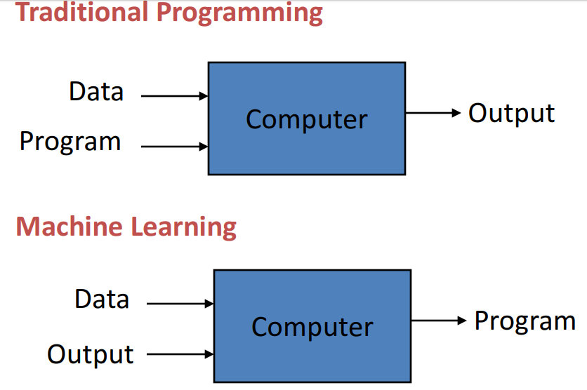
What is Machine Learning?
Machine learning is a method of data analysis that automates analytical model building.
It is a branch of artificial intelligence based on the idea that systems can learn from data, identify patterns and make decisions with minimal human intervention.

Slide 3
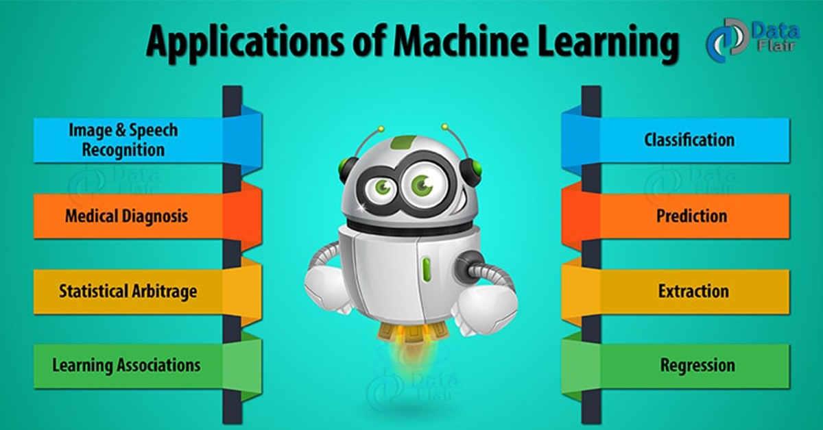
When Do We Use Machine Learning?
Machine Learning provides smart alternatives to analysing vast volumes of data. By developing fast and efficient algorithms and data-driven models for real-time processing of data, Machine Learning can produce accurate results and analysis.

Slide 4
Why Now?
Flood of available data
Increase computational power
Growing progress in available algorithms and theory developed by researchers
Increasing support from industries

Slide 5
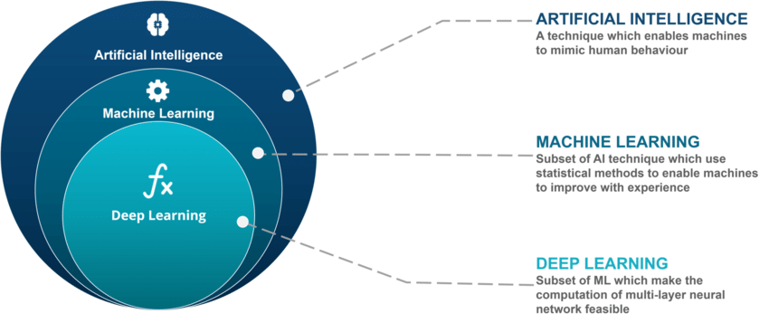
Where Machine learning Stands

Slide 6
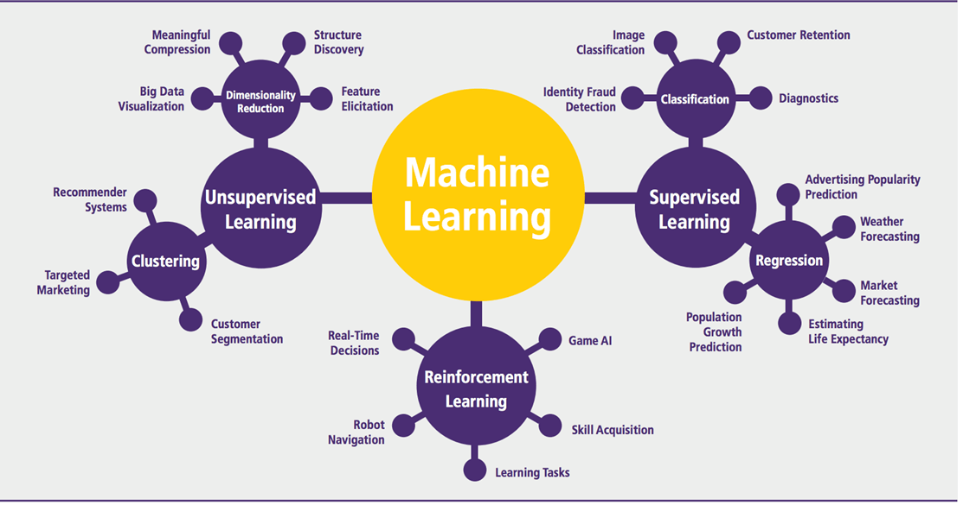
Branches of Machine Learning

Slide 7
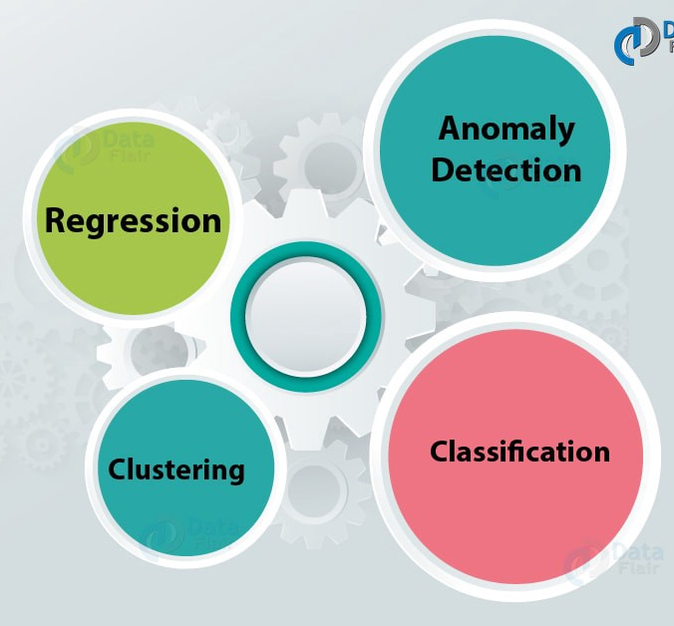
Types of Machine Learning

Slide 8
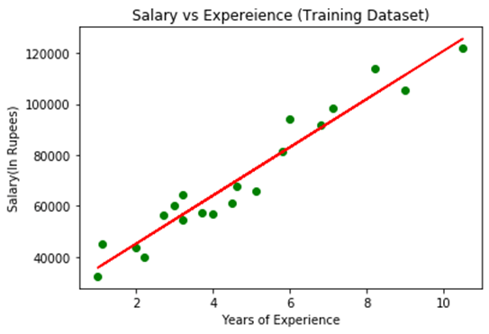
Introduction to Regression Analysis
Regression analysis: Predict the value of a dependent variable based on the value of at least one independent variable
Simple Linear Regression

Slide 9
Regression
Simple Linear Regression
Multiple Linear Regression
Polynomial Regression
Logistic Regression
Lasso Regression
Ridge Regression
A linear regression model with a single explanatory variable
A linear regression model with multiple explanatory variable
Here the relationship between the independent variable x and dependent variable y is modelled as an nth degree polynomial
It uses a logistic function to model a binary dependent variable
Performs L1 regularization by adding penalty equivalent to Absolute value of the magnitude of coefficients
Performs L2 regularization by adding penalty equivalent to square of the magnitude of coefficients

Slide 10
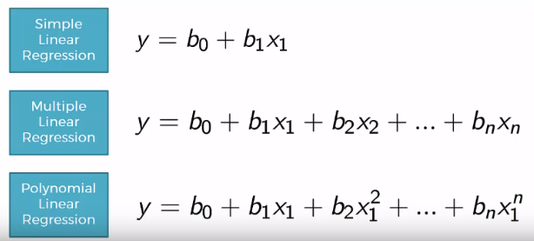
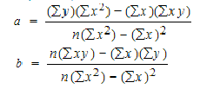
The Linear Regression Equation
The equation has the form Y= a + bX, where Y is the dependent variable, X is the independent variable, b is the slope of the line and a is the y-intercept.

Slide 11
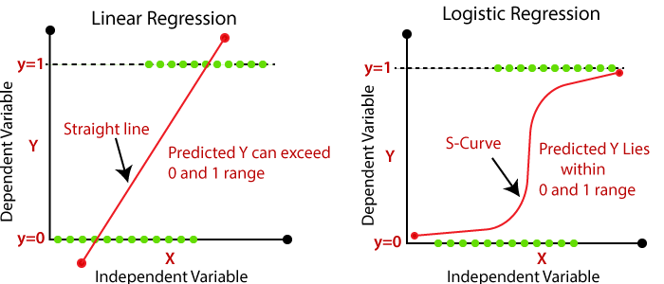
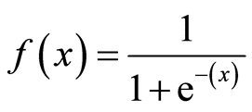
Linear & Logistic Regression

Slide 12
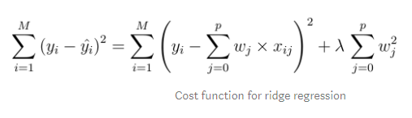
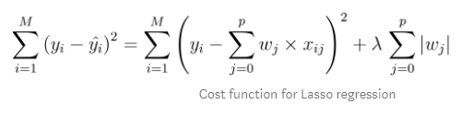
Ridge & Lasso Regression
In ridge regression, the cost function is altered by adding a penalty equivalent to square of the magnitude of the coefficients.
The cost function for Lasso (least absolute shrinkage and selection operator) regression can be written as

Slide 13
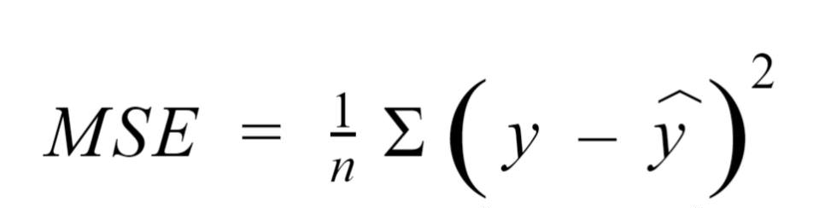
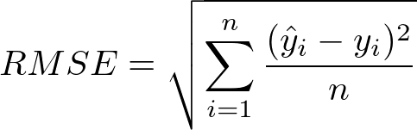
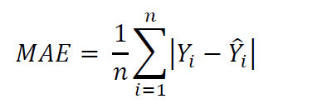
Evaluate the Model Results
Mean Squared Error(MSE) - represents the difference between the original and predicted values extracted by squared the average difference over the data set.
Root-Mean-Squared-Error(RMSE) - is the error rate by the square root of MSE.
Mean-Absolute-Error(MAE) - represents the difference between the original and predicted values extracted by averaged the absolute difference over the data set
R² or Coefficient of Determination.
Adjusted R²

Slide 14

R-Square
R-squared (R²) is a goodness-of-fit measure for linear regression models. This statistic indicates the percentage of the variance in the dependent variable that the independent variables explain collectively.
R-squared is always between 0 and 100%:
0% represents a model that does not explain any of the variation in the response variable around its mean. The mean of the dependent variable predicts the dependent variable as well as the regression model.
100% represents a model that explains all of the variation in the response variable around its mean.

Slide 15
R-Square - limitations
You cannot use R-squared to determine whether the coefficient estimates and predictions are biased, which is why you must assess the residual plots.
R-squared does not indicate if a regression model provides an adequate fit to your data. A good model can have a low R² value. On the other hand, a biased model can have a high R² value!
Are Low R-squared Values Always a Problem?
No! Regression models with low R-squared values can be perfectly good models for several reasons.
Some fields of study have an inherently greater amount of unexplainable variation, For example, studies that try to explain human behavior generally have R² values less than 50%. People are just harder to predict than things like physical processes.

Slide 16
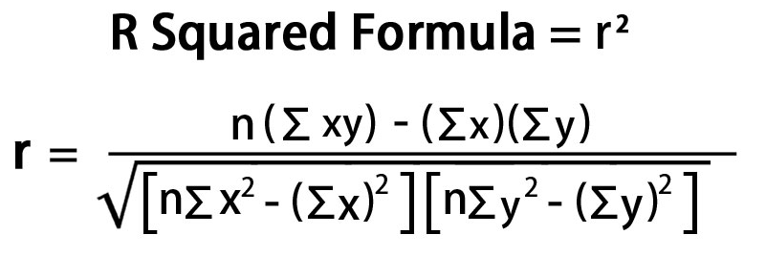
R-Square - Formula

Slide 17
Adjusted R Square
The adjusted R-squared is a modified version of R-squared that has been adjusted for the number of predictors in the model. The adjusted R-squared increases only if the new term improves the model more than would be expected by chance.
Relation between R square & Adjusted R Square
R2 shows how well terms (data points) fit a curve or line. Adjusted R2 also indicates how well terms fit a curve or line, but adjusts for the number of terms in a model. If you add more and more useless variables to a model, adjusted r-squared will decrease. If you add more useful variables, adjusted r-squared will increase.
Adjusted R2 will always be less than or equal to R2.

Slide 18
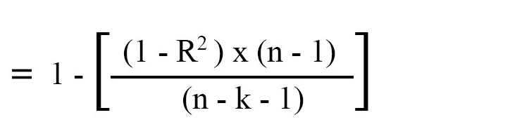
Adjusted R Square - Formula
R Squared is used to determine the strength of correlation between the predictors and the target.
Adjusted R Squared has the capability to decrease with the addition of less significant variables, thus resulting in a more reliable and accurate evaluation.

Slide 19
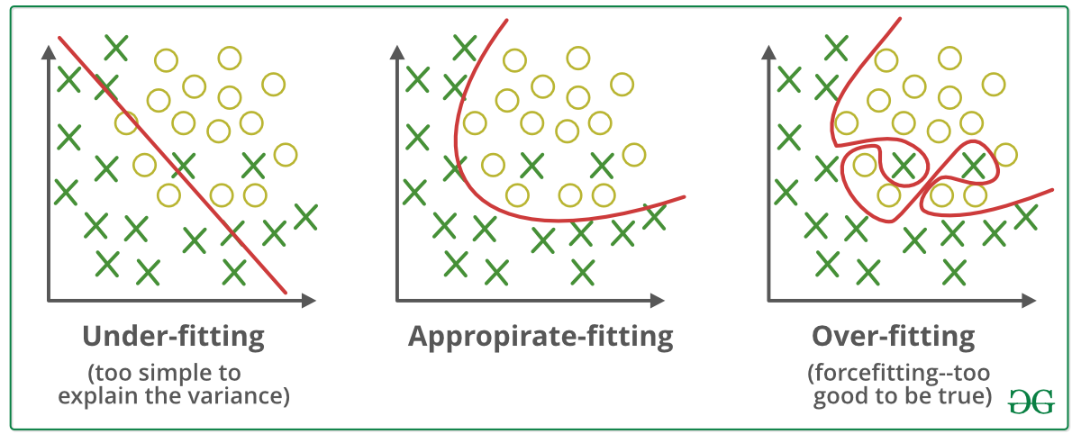
Over Fitting & Under fitting
Over-fitting: Good performance on the training data, poor generalization to other data.
Under-fitting: Poor performance on the training data and poor generalization to other data

Slide 20
Over Fitting & Under fitting
Generalization in Machine Learning - refers to how well the concepts learned by a machine learning model apply to specific examples not seen by the model when it was learning.
Statistical Fit - refers to how well you approximate a target function.
Over-fitting refers to a model that models the training data too well.
Under-fitting refers to a model that can neither model the training data nor generalize to new data.
A Good Fit in Machine Learning - Ideally, you want to select a model at the sweet spot between under-fitting and over-fitting. Using cross validation is a gold standard in applied machine learning for estimating model accuracy on unseen data.

Slide 21
Avoiding Over fitting & Under fitting
Cross-validation
Train with more data
Remove features
Early stopping
Regularization
Ensembling
Under fitting can be avoided by using more relevant data and also reducing the features by feature selection

Slide 22
The Big Picture
Gathering data
Preparing that data
Choosing a model
Training
Evaluation
Hyperparameters tuning
Prediction.

Slide 23
Assumptions of Linear Regression
Linearity – There should be a Linear Relationship between the Dependent & Independent Variables
Homoscedasticity - The error between the independent and the dependent variable is the same across all values of the independent variables.
Multivariate normality - that any linear combination of the variables is also normally distributed
Independence of errors - Distribution of errors is random and not influenced by or correlated to the errors in prior observations.
No auto-correlation - No identifiable relationship exists between the values of the error term
No or little Multicollinearity – There should be no correlation between the independent variables
A note about sample size - In Linear regression the sample size rule of thumb is that the regression analysis requires at least 20 cases per independent variable in the analysis.

Slide 24
Thanks

